Slide 1
Angular
Day 3

Slide 2
Objectives
Interpolation
Angular Core Concepts
Directives and Pipe
Services.
Working with Components

Slide 3
Interpolation
Displaying values with interpolation
Interpolation refers to embedding expressions into marked up text. By default, interpolation uses the double curly braces {{ and }} as delimiters.

Slide 4
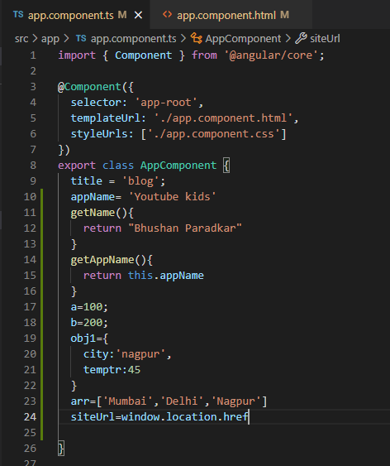
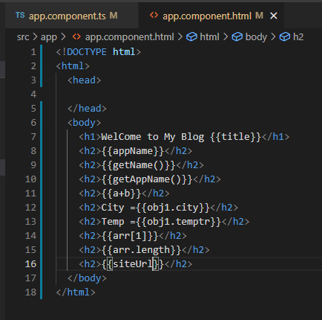
Example for interpolation-

Slide 5
Directives and Pipes
Directives:
What Are Directives in Angular?
In Angular, Directives are defined as classes that can add new behavior to the elements in the template or modify existing behavior.
The purpose of Directives in Angular is to maneuver the DOM, be it by adding new elements to DOM or removing elements and even changing the appearance of the DOM elements.
Types of Directives in Angular
Component Directive
Special directives in Angular are called Components since this type of directive has a template or template URLs. In effect, it is a component directive that shows something in DOM.
Structural Directive
This type of directive is used to make changes in the layout of the DOM. Elements can be added or removed, hence changing the structure of the DOM. An example would be *ngIf(adding or removing element from DOM) or *ngFor(lists elements of every iteration).
Attribute directive
This type of angular directive is used to make behavior or element changes in the appearance and behavior of an element. For example, ngStyle( applying styles) or ngClass(applying CSS classes).

Slide 6
Directives and Pipes
Directives:
Component Directive
Component Directives: It forms the main class and is declared by @Component.
It contains the details on component processing, instantiated and usage at run time. Example: It contains certain parameters some of them are shown in this example.
@Component({
selector: 'app-root',
templateUrl: './app.component.html',
styleUrls: ['./app.component.css']
})
There are three parameters discussed below:
Selector: Tells the template tag which specifies the beginning and end of the component.
templateURL: Consists of the template used for the component.
styleUrls: It is of array type which consists of all the style format files used for the template.

Slide 7
Directives and Pipes
Directives:
Structural Directives: Structure directives manipulate the DOM elements. These directives have a * sign before the directive. For example, *ngIf and *ngFor. Example: Let’s look the implementation of *ng-if-else and *ng-for. Using them, we classify courses for Freshers or Laterals.
To understand <ng-template> → https://angular.io/api/core/ng-template
To understand <ng-container> → https://angular.io/api/core/ng-container

Slide 8
Directives and Pipes
Directives:
Custom Directives
We can also create our own directive which is called as custom directives.
Example: If we will have to create a custom directive to change text then we can create custom directive for this purpose by firing given below command.
ng g directive changeText

Slide 9
Directives and Pipes
Pipes
Use pipes to transform strings, currency amounts, dates, and other data for display. Pipes are simple functions to use in template expressions to accept an input value and return a transformed value. Pipes are useful because you can use them throughout your application, while only declaring each pipe once. For example, you would use a pipe to show a date as April 15, 1988 rather than the raw string format.
For example, you would use a pipe to show a date as April 15, 1988 rather than the raw string format.

Slide 10
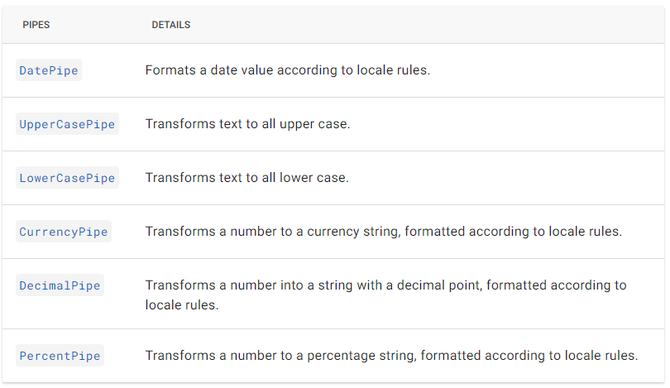
Directives and Pipes
Pipes
Angular provides built-in pipes for typical data transformations, including transformations for internationalization, which use locale information to format data. The following are commonly used built-in pipes for data formatting:
For a complete list of built-in pipes, see the pipes API documentation.

Slide 11
Directives and Pipes
Pipes
Basic example:
As we have seen concept of pipes. Let’s simplify it and understand with example.
In Angular 1, filters are used which are later called Pipes onwards Angular2. In Angular 7, it is known as pipe and used to transform data. It is denoted by symbol |
Syntax:
{{title | uppercase}}
Pipe takes integers, strings, arrays, and date as input separated with |. It transforms the data in the format as required and displays the same in the browser.

Slide 12
Angular Core Concepts
Services:
Services provides specific functionality in an Angular application. In a given Angular application, there may be one or more services can be used. Similarly, an Angular component may depend on one or more services. In simple words we can say it’s reusable type script class.
Why use Services?
Let’s understand it with example.
We have a component component1 in which there is a button for displaying greet message. So we will have to write a method for this in ts file of respective component. If we have second component and have to implement same thing again. What if we will have 50 components and in all components we have to implement same functionality?
Services can also use for component communications.
If we have to set some data which will be used in our application by
multiple components then we can use service.
Service
Greeting
Component 1
Component 2
Greeting
Greeting

Slide 13
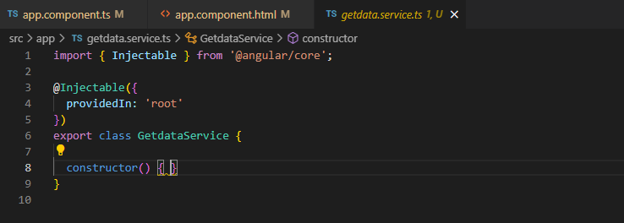
Angular Core Concepts
Services:
Services provides specific functionality in an Angular application. In a given Angular application, there may be one or more services can be used. Similarly, an Angular component may depend on one or more services. In simple words we can say it’s reusable type script class.
Create Angular service
An Angular service is plain Typescript class having one or more methods (functionality) along with @Injectable decorator. It enables the normal Typescript class to be used as service in Angular application.
How to create service?
In order to create service we have to fire simple command.
ng generate service service_name

